Slide 1
Microfinance for Migrants in the European Union
A Belgian story

Slide 2
About us

Slide 3
A group of Social Entreprises
microStart SCRL-FS
Cooperative company
Social Purpose
Capital: 3,2 M EUR
18 employees
microStart support asbl
Non For Profit
Subsidized
Budget: 500 K EUR
4 employees & 100 volunteers
3

Slide 4
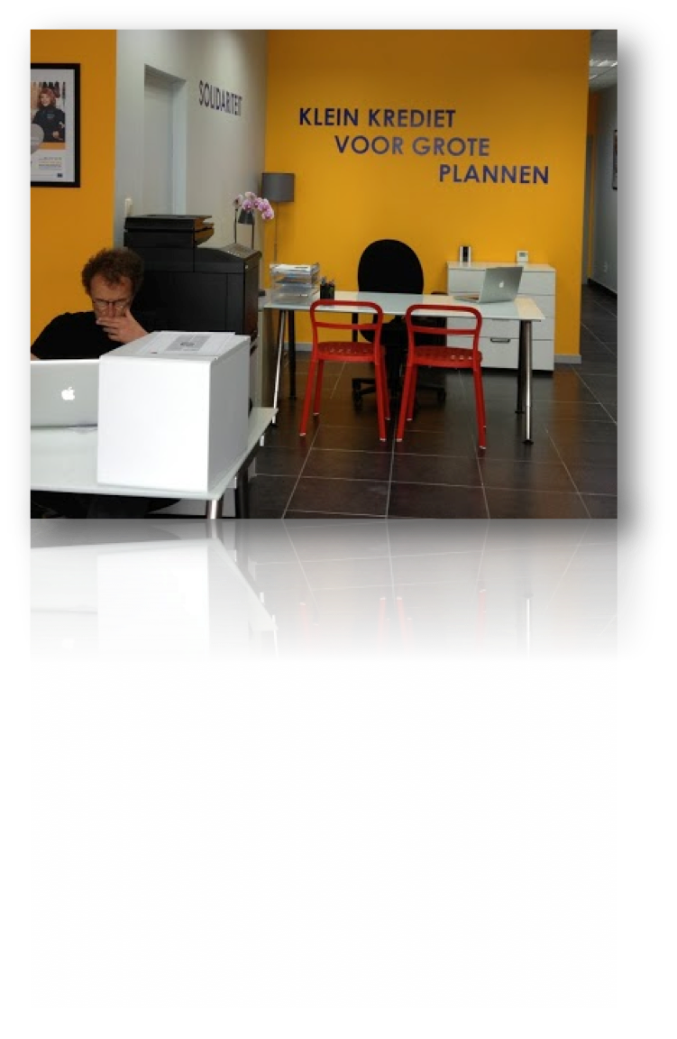
Network of 6 branches
4

Slide 5
Products & Services
Business Loans
100-15.000 EUR
48 Installments max.
Fees: 5% upfront
Interest Rate: 8,95%-9,95%
Individual-Group Lending
Investment-Treasury
Business Development Services
Idea ➔ Development
Expert Meetings
Group Trainings
Individual Coaching
Free of Charge
Provided by Volunteers
5

Slide 6
What we compete

Slide 7
THE GAP
risk of poverty and social exclusion
migrant population 35%
Europe
people living where they were born 20%
migrant population 51%
Belgium
people living where they were born 13%
Source : Anthony Albertinelli, Bettina Knauth, Katarzyna Kraszewska, David Thorogood,
"Migrants in Europe", Eurostat Statistical books, European Commission, 2011

Slide 8
Belgians struggle against poverty = crossing the gap
In Belgium
employees and non-actives becomes less entrepreneurs
then the european average

Slide 9
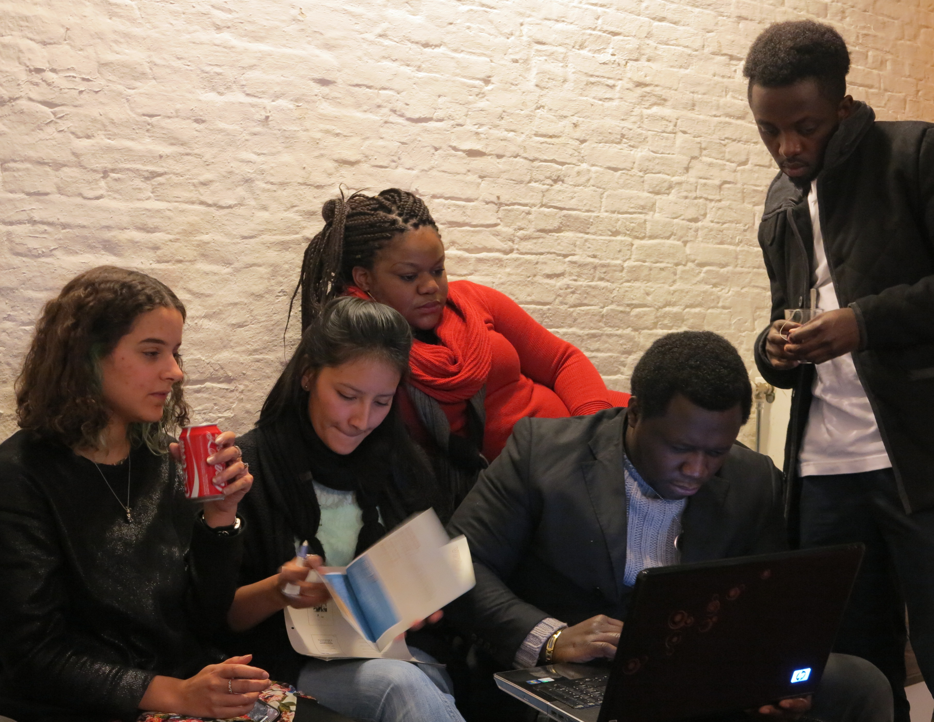
What we do

Slide 10
First believer
Validates
Confidence
Structure
Social Mining
Microcredit
Coaching & training
Advocacy

Slide 11
Social Mining
Fast & simple procedures
positioning
Third actor : bridging the gap Representable crew Shopfront in popular neighbourhood Clear goal – simple message
Social mining Cross sector cooperation Reception agency for integration / antipoverty org / community org Clear relationship : first contact = advisor Pragmatic, Tailor-made personal solutions Average 10 days to obtain microcredit answer
process

Slide 12
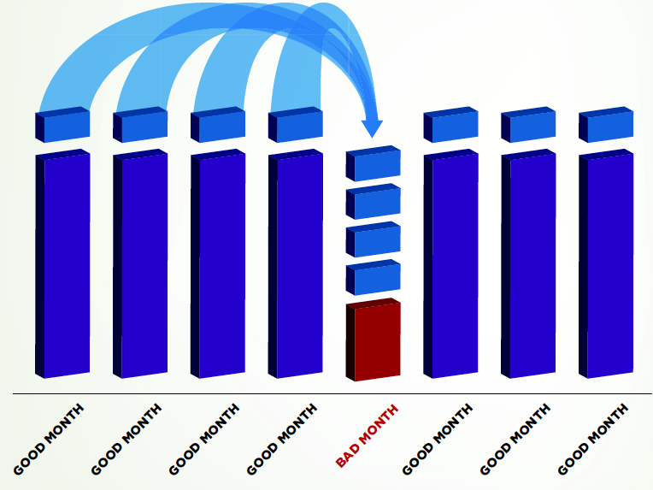
Flexible payment

Slide 13
Guarantee
Third Person is guarant for ½ sum
Experimentation
Guarantee by saving 25% sum

Slide 14
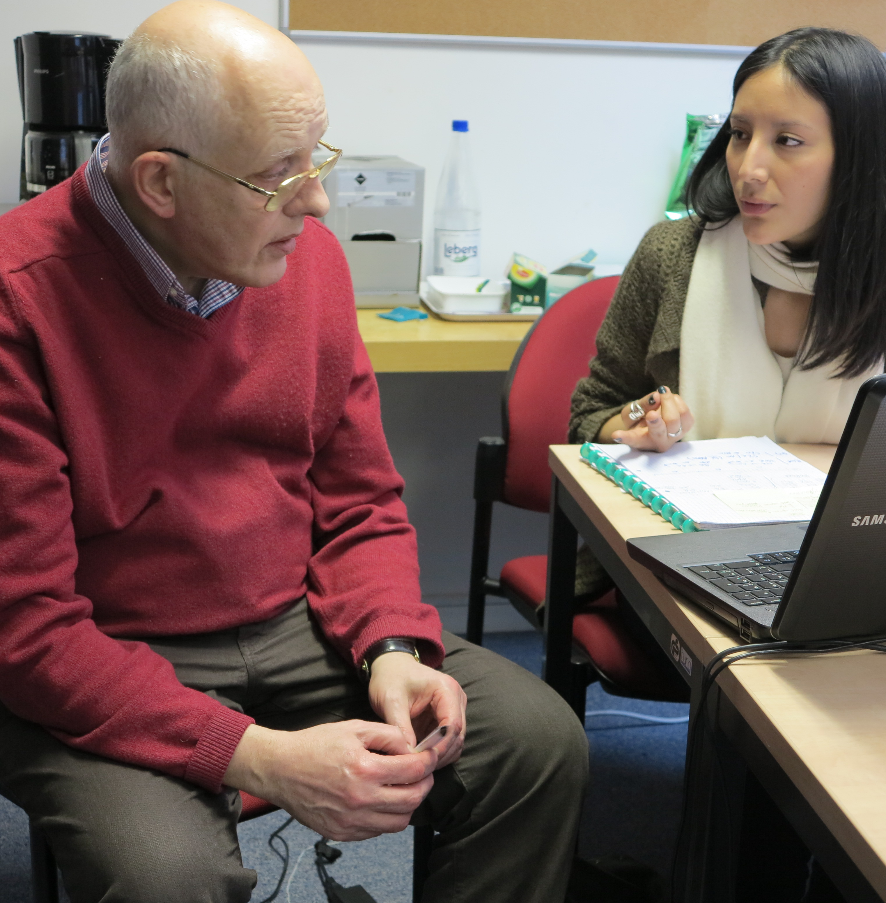
preparation
Launch
development
Project development dreamStart / KickStart / permanences Preparatory for examen Marketing Financial and administrative gestion
coaching
By 100 volonteering experts
Social adventure
Experienced more value

Slide 15
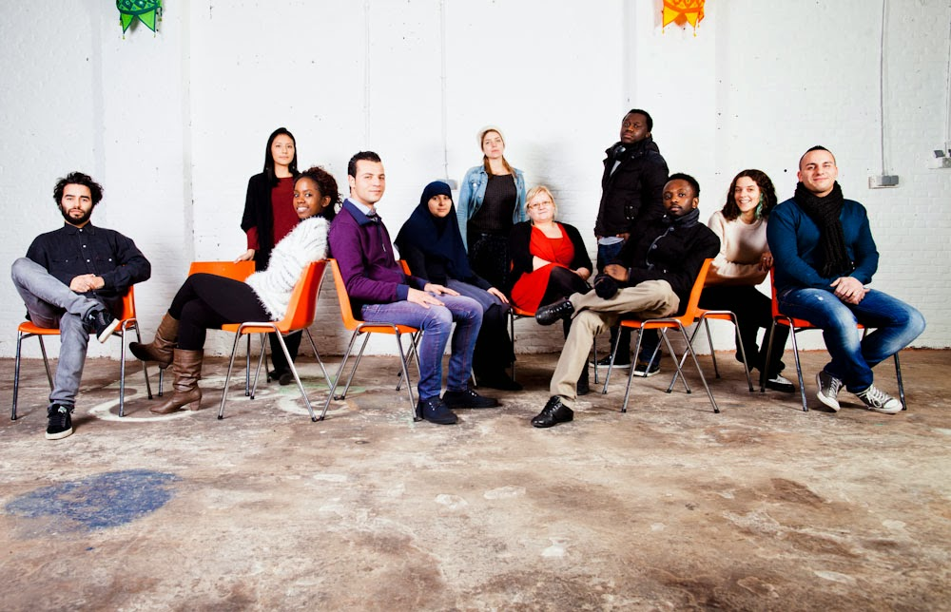
2 months 3 days/week

Slide 16
Opportunities for migrants to be entrepreneurial
Validates the local knowhow on 2 places in the world
Validates know how achieved abroad
Dynamic “nature” of migrants

Slide 17
Obstacles to entrepreneurship
obstacles | Solutions (partielles)
Lack of social renumeration | Coopérative d’activités
Sociale taxes | - Coopérative d’activités - Exonération des cotisations sociales - Indépendant complémentaire
Examen | - Formation certifiante - Jury central en gestion - Jury central pour certaines professions - Validation des compétences: reconnaissance de l’expérience

Slide 18
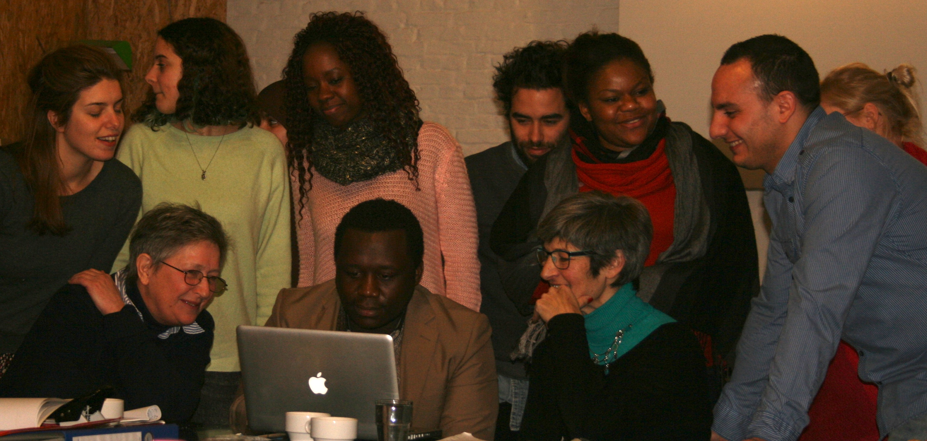
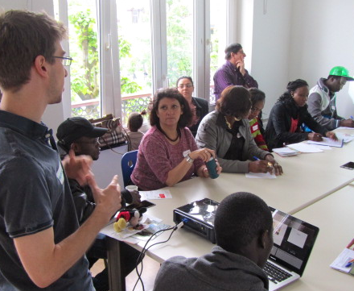
FOR WHOM?

Slide 19
about 90% is not born in Belgium

Slide 24
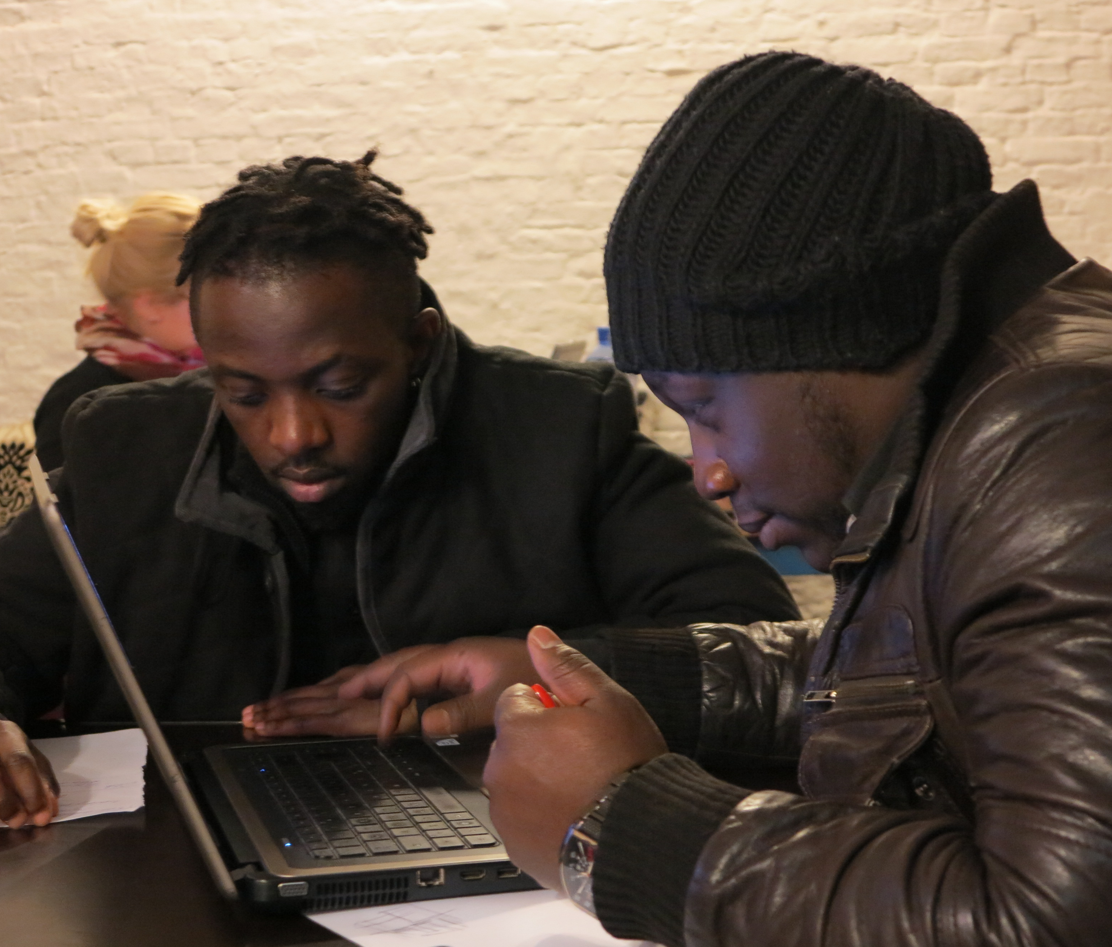
Where it leads to

Slide 25
5040€
Average microcredit

Slide 26
4469
contacts

Slide 27
1000
Microcredits

Slide 28
Thank you for your attention

Slide 29
vis
www.microStart.be

