Slide 1
Campaigns
Your guide to electoral success
LUDEN Women into Politics
01/04/2014

Slide 2
What we will cover today
Your decision to run & for what election
Building your team
Research
Your Path to Election

Slide 3
3 Key Messages
Know your numbers!
You don’t need as many votes as you might think
You do not need universal appeal

Slide 4
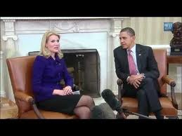
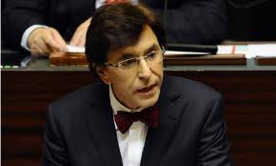
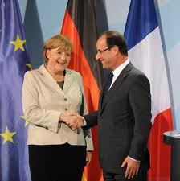
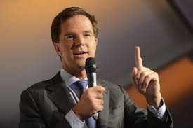
So! You want to run for election?
Helle Thorning-Schmidt
Elio Di Rupo
Angela Merkel, Francois Hollande
Mark Rutte
David Cameron

Slide 5
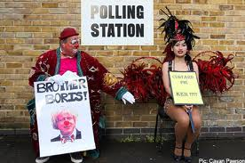
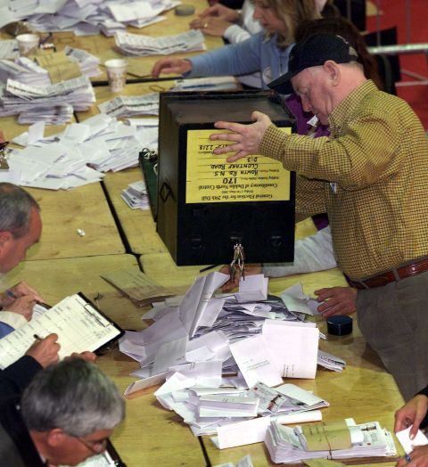
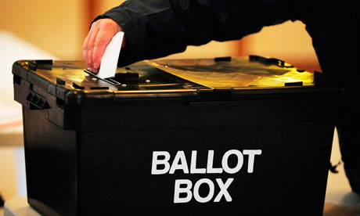
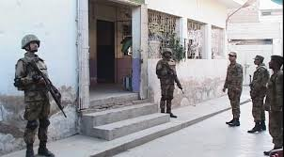
Elected by the ballot box – and its TOUGH!

Slide 6
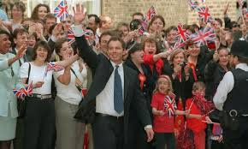
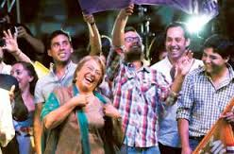
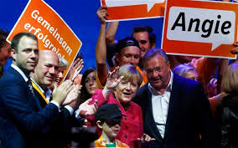
What victory looks like

Slide 7
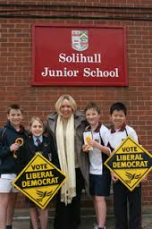
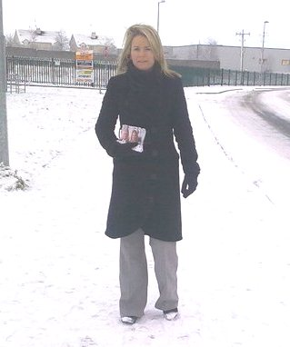
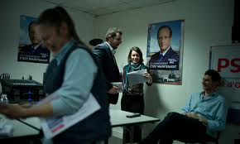
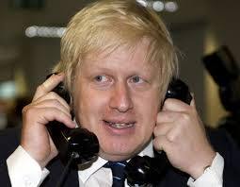
What the reality looks like

Slide 8
Engage your electorate
Academic Research and Electioneering evidence both confirm that canvassing and voter engagement is the most impactful technique for getting elected. Gerber & Green US Brannan & John UK

Slide 9
Time to ask yourself….
What skill, experience, passion do you bring to a campaign?
Are you physically prepared for long hours, little sleep, snacking, poor lifestyle ?
Are you prepared for probing questions from the public and media (have you a thick skin)?
Have you anything in your background, that shouldn’t be made public?
Have you discussed this with your family in terms of the potential hours and the intrusion?
Are you compromising on your job or your business or your family?
How are you in both victory and defeat ?

Slide 10
So! Why do you want to run?

Slide 11
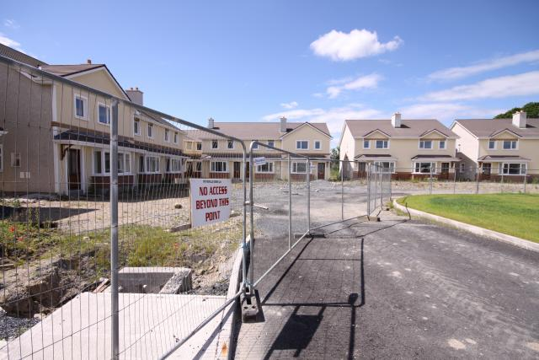
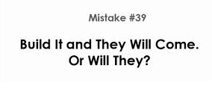
Don’t assume

Slide 12
Build your team
How to build a movement…

Slide 13
Dear Lone Nut,
Who was your first follower?

Slide 14
THE CAMPAIGN TEAM

Slide 15
Listening to your team

Slide 16
Who is in your campaign team
Every campaign is different and every candidate is different.
KEY MESSAGE
If you as a candidate have only got three people on your entire team, one must be your campaign manager; one must be your election agent; the other needs to assist with admin and canvassing.

Slide 17
The Election Agent Role may be filled by Party National Director of Elections or Constituency Director of Elections The Fundraising Role may be filled by Party Headquarters or local Constituency Organisation
 | Town / Borough Council | City / County Council | General / Legislative Election | Senate Election | European Parliament | Mayoral Election | Presidential Election
Campaign Manager | X | X | X | X | X | X | X
Admin & Diary Manager |  | X | X | X | X | X | X
Election Agent *(1) | X | X | X | X | X | X | X
Driver(s) |  |  | X | X | X | X | X
Volunteer / Canvasser Co-ordinator |  | X | X | X | X | X | X
Press Officer |  |  | X |  | X | X | X
Fundraiser *(2) |  |  | X |  | X | X | X
Online & IT Manager |  | X | X | X | X | X | X
Canvassers | X | X | X | X | X | X | X

Slide 18
Your Campaign Manager
Your Campaign Manager has five distinct jobs
To draw up along with you, your campaign plans understanding that there is a huge difference between ‘getting elected’ and ‘getting nominated’
Path to Selection
Path to Election
To get your candidacy launched.
To get you selected as a candidate.
To build a team and run the campaign according to the campaign plan.
To get you elected.

Slide 19
The campaign manager v’s the campaign advisor

Slide 20
How many people do I need?
Do you have 3 friends or family or party supporters that could devote their resources and time to you and your campaign?
Depending upon your election type, you could do it with 2 or 3.
Yes it's easier with more.
But 100’s of helpers don't matter if they are not working to the Path to Election Plan

Slide 21
Other key roles
Election Agent
Legislative details
Good with detail and legal matters
Canvassing manager / Team
Implements canvassing strategy
Manages canvassing team
Good with people
Online Manager
Builds & manages your social media
Good with tech and communicating

Slide 22
The candidate should NEVER attempt to be the campaign manager, irrespective of the size of the election

Slide 24
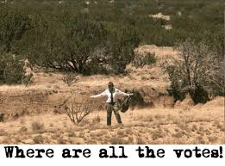

Slide 25
Where will the votes come from?
This question will have a different answer in each constituency and for each candidate.
You research should potentially point to clues.
You need to set realistic targets for each area of your constituency.
The previous tallies are crucial here in making very good estimates of future voting patterns.

Slide 26
2011 General Election Lowest actual first preference vote by Party that got elected to the 31st Dáil
Party | T.D | Constituency | First Preference % vote | Number of 1st Preference Votes | First preference vote as % of total electorate
Fianna Fáil | Robert Troy | Longford-Westmeath | 7.4 | 4275 | 4.9
Fine Gael | Sean Kyne | Galway West | 7.5 | 4550 | 5.1
Independent | Maureen O’Sullivan | Dublin Central | 11.96 | 4139 | 7.3
Labour | Kevin Humphreys | Dublin South East | 9.88 | 3450 | 5.9
Sinn Fein | Mary Lou McDonald | Dublin Central | 13.08 | 4526 | 8.0
ULA | Richard Boyd Barrett | Dun Laoghaire | 10.9 | 6206 | 7.7

Slide 27
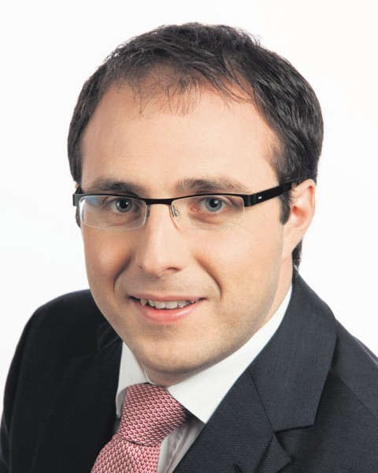
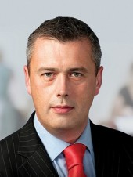
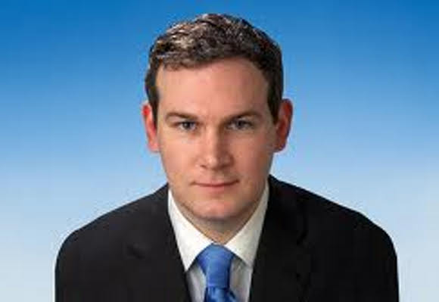
Robert Troy (FF) 4.9%
Colm Keaveney (Labour) 5.0%
Sean Kyne (FG) 5.1%
On average they received just 5 votes out of every 100 voters registered in their constituencies.
You don’t need universal appeal to get elected.

Slide 28
2010 General Election UK Actual first preference vote by candidates related to total electorate
Party | T.D | Constituency | First Preference % vote | Number of 1st Preference Votes | First preference vote as % of total electorate
Labour | Henrick MP | Preston | 48.20 | 15668 | 25.6
Labour | Seabeck AJ | Plymouth Moor View | 37.16 | 15443 | 22.62
Labour | Denham JY | Southampton Itchen | 36.76 | 16326 | 21.72

Slide 29
Dear Candidate,
What is your number?

Slide 30
How will you achieve your target number of votes?
By having….
A canvassing plan
A good Online strategy
An advertising plan
An effective poster plan
A plan around direct Mail or email campaigning or a combination
A plan for leaflets and literature you will use
FAIL TO PLAN….PLAN TO FAIL

Slide 31
Step by Step
Begin to build your team, as early as possible.
Finalise your candidate selection plan ‘Path to Nomination’
Formally announce your candidacy to your party– (eg a formal letter to all voting delegates in your party; officially at a party meeting; in a letter to party leader)
Formally announce your candidacy to the public – (E.G. Press release your decision (Link to Communications section of document)
Seek out media opportunities on foot of your candidacy – (Link to Communications section)
Seek a meeting with your party headquarters (if you haven’t already done so), or the most senior person in your party that is responsible for candidate selection and campaign strategy. Outline your ‘Path to Election’ document which demonstrates how you can win.
Expand outside your existing circle or geographical area – seek out meetings with potential supporters and or influencers throughout your constituency
Implement your ‘Path to Nomination’ strategy in order to get selected. This will include operating within the specifics of the political party selection processes. Meet with local party members, constituency organisers, other public reps (where appropriate)
Seek out speaking opportunities in areas and with groups that are not familiar to you.
Stick to your message (reference communications piece) – practice it and refine it. It is in those small meetings and one-on-one sessions that you will find your key words and key messages.
Attempt to get local and or national endorsements
Update and improve your campaign plan ‘Path to Election’

Slide 32
Getting selected

Slide 33
The candidate cycle
Candidates
ELECTORAL
SUCCESS
Conventions
Strategy

Slide 34
Pre-candidate selection / Conventions
Insider
Outsider
Raise profile
Speak at meetings
Constituency Officer
Go for the key positions
Run events
Get experience of running campaigns
Raise profile
Develop network
Get involved in Community/other organisations
Media profile
Notes:
Seven elements – write them out and get moving
NG do a draft plan with these for people
We will go through some of these with you
ow much do you need?
How do you break that figure down?
Who is raising the money?
How are they raising it?
How are you managing your fundraising?
Remember – you can’t spend money until you raise money – so this should be one of the things that you think about EARLY.
Planning this is something that you can be doing in the weeks to the boundary commission report

Slide 35
Know your system
Candidate selection / conventions
Nominations Process
Who calls the shots?
Who does what?
Who, what, where, when, how?
Who seeks nominations?
Who can nominate?
Units? Members?
Understand the timeframe
Get to meet members

Slide 36
The strategy committee
priorities
assessment
other parties
Recommendations
Notes:
Price it out

Slide 37
Your Challenge
Know your electorate
Canvass everyone
Build a team
Recruit people who add value
Find ‘Champions’
Notes:
Schedule your review for an agreed date each month with your campaign manager and fundraiser
If it is not on target you need to adjust your plans
A good fundraiser is impressive to any political party – this is another way of showing that you are serious about getting elected

Slide 38
The details that matter
As an election candidate, you will not be expected to know the minutiae or intricacies of all the various pieces of electoral legislation and regulation BUT someone on your team MUST know!
In all cases it is advisable to seek the advice of an experienced Election Agent or Director of Elections, via your own party structure.
For Independent candidates, it may be necessary to refer such matters to a solicitor, if you do not have access to an experience Election Agent or Director of Elections. For all electoral legislation visit
Worldwide: http://www.ipu.org/parline-e/parlinesearch.asp and http://legislationline.org/

Slide 39
Challenges while running for election

Slide 40
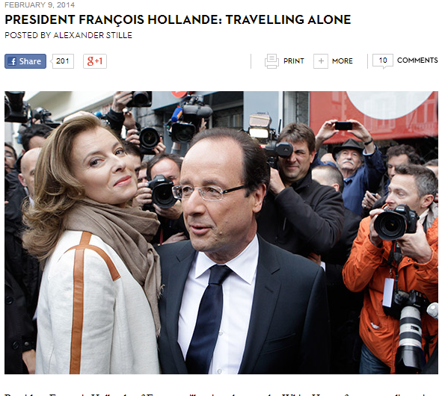
Public Scrutiny

Slide 41
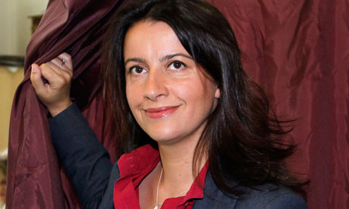
Sexism?
Last year, Cecile Duflot, the French housing minister, endured wolf-whistles as she delivered a speech in the national assembly. Defending the incident, Patrick Balkany, who is close to Nicolas Sarkozy, said he was merely "admiring" Duflot, adding that she had chosen the dress she was wearing (a fairly conservative floral dress, if it matters) "so we wouldn't listen to what she was saying". Another politician said the wolf-whistles had been "in tribute" to her.

Slide 42
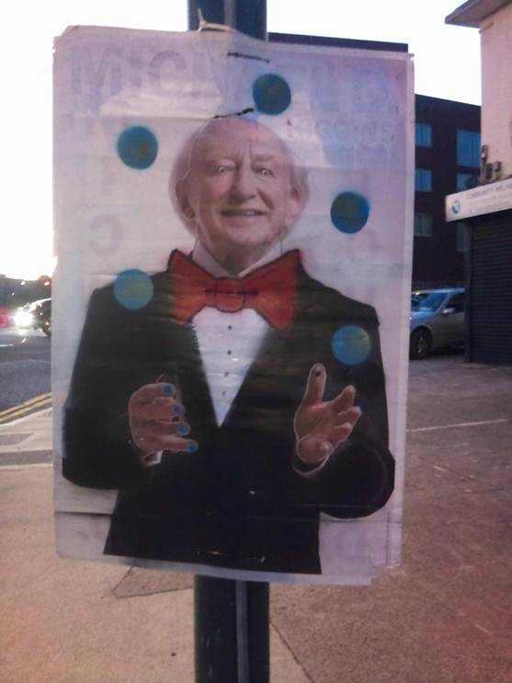
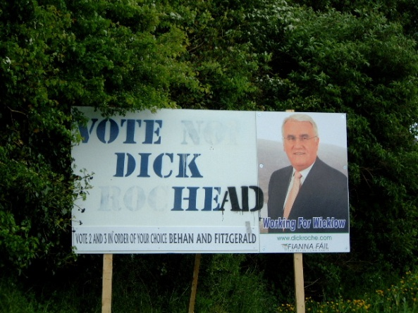
Personal criticism

Slide 43
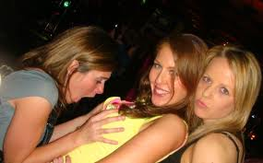
Silly Mistakes!
Emma Kiernan, Newbridge Town Council
Notes:
Emma Kiernan, Newbridge Town Council

Slide 44
Are your family happy to participate?

Slide 45
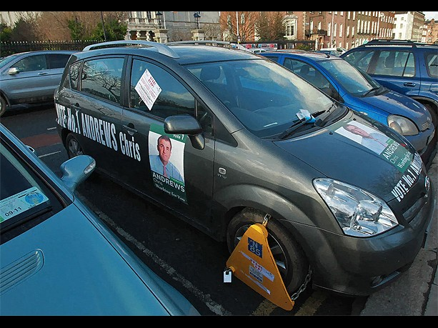
Even sillier mistakes!

Slide 46
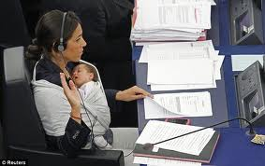
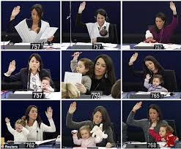
Managing family life and politics

Slide 47
Next Steps

Slide 48
Start early
The electorate do reward early contact with candidates and they do reward contact with candidates outside of election cycles.
It’s never too early to start your political campaign. avail of any opportunity to increase your profile and enhance your candidacy.
Set out in your campaign plan what the campaign structure will be based on available resources and available personnel.
Be realistic; don’t put people in roles, where they can’t commit full time

Slide 49
Voting
Understand the voting rights within your country
Ensure you have access to the register of electors
Ensure everyone you know and their families are on the register of electors
Encourage and help your constituents to add themselves to the register of electors

Slide 50
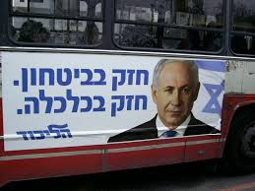
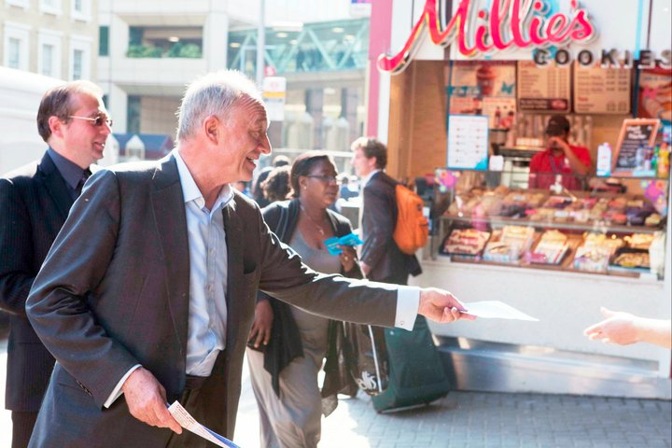
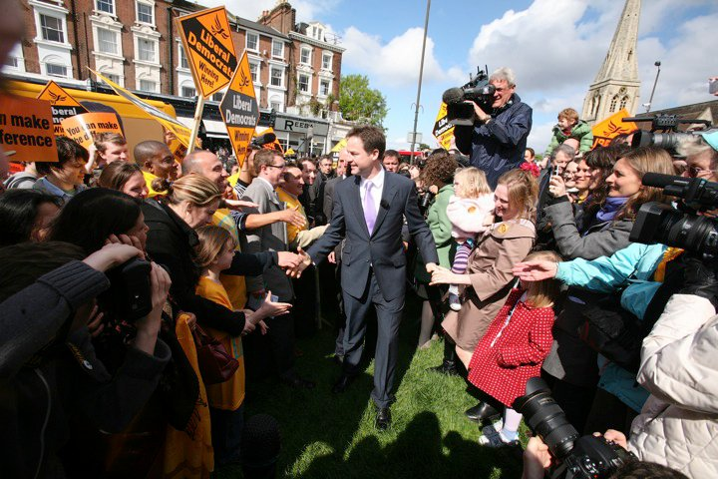
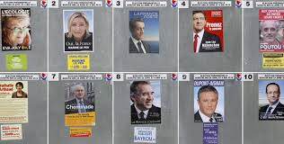
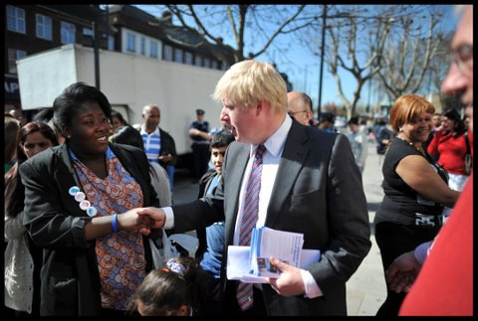
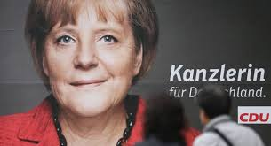
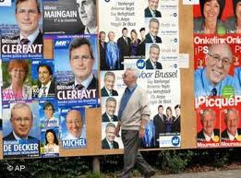
Key ingredients to your success – Voter Contact!

Slide 51
Final Words
The smallest team can win
The biggest spenders in elections don’t always win
You don’t need as many votes as you think
Go build a team and make it your team
Ask for help!
You can do it!

Slide 52
