Slide 1
More Women in European Politics
More women in 2014
How close are we?
Dr Maria Pothoulaki
Family and Childcare Center - KMOP
With financial support from the “Fundamental Rights and Citizenship” Programme of the European Union

Slide 2
Project Activities – Implementation status
Local Action Group
Baseline Study – Women in Politics
Implemented (analysis of the position of women in politics at 3 levels – European level, National Level and Local Government Level)
Participation in Project’s Transnational Workshops
1st Transnational Workshop (16-20 September 2013, Tallin, Estonia)
2nd Transnational Workshop (2-5 June 2014, Athens, Greece)
Design and Implementation of Local Action Strategy/Campaign
Candidate support program
Market Research/Web survey
Design completed / Implementation almost completed
Training Program for Women Candidates and Potential Candidates (16-17 January 2014)
8 meetings planned to take place throughout the project – 7 have taken place so far
With financial support from the “Fundamental Rights and Citizenship” Programme of the European Union

Slide 3
Target Group – National Context
Target Group:
Women / Young Women
Political Parties & Women associations
Women Organizations
General Public
With financial support from the “Fundamental Rights and Citizenship” Programme of the European Union

Slide 4
Axes of Local Action Strategy/Campaign
Awareness Raising Activities
Candidate Support Program Activities
Dissemination Activities
Local
Action
Strategy
With financial support from the “Fundamental Rights and Citizenship” Programme of the European Union

Slide 5
Local Action Strategy/Campaign
Priorities and activities were designed based on our national context and findings from our Baseline study
The time plan of activities was decided based on national milestones
EP elections
Local Government elections
With financial support from the “Fundamental Rights and Citizenship” Programme of the European Union

Slide 6
Local Action Strategy/ Campaign
AWARENESS RAISING
ACTIVITIES
Website / E-kiosk
Facebook Page
Workshops
Press Releases
Radio Spot
Campaign Logo
With financial support from the “Fundamental Rights and Citizenship” Programme of the European Union

Slide 7
Awareness raising activities – Website www.dosetostigmasou.gr
With financial support from the “Fundamental Rights and Citizenship” Programme of the European Union

Slide 8
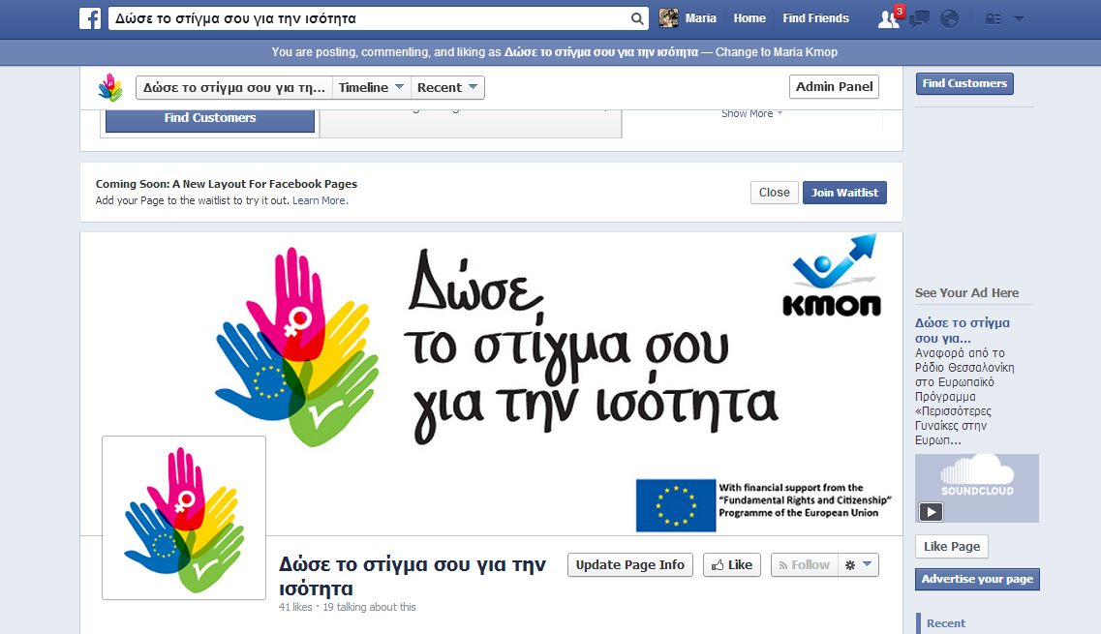
Awareness raising activities – Facebook Page
With financial support from the “Fundamental Rights and Citizenship” Programme of the European Union

Slide 9
Awareness raising activities – Workshop I
One day Workshop – informative nature/launch event
Friday 22 November 2013, Hotel Titania, Athens
61 participants
14 speakers
Thematic sections:
‘Presentation of the Project’
‘Priority to Equality – The European Perspective’ (Speakers: Representative of the European Commission Office in Greece, Representative of the European Parliament Office in Greece, Head of the Greek Coordination of European Women’s Lobby)
‘Strengthening Women in Politics-Tendencies and Approaches’ (Speakers: Representatives from Women Associations of Political Parties)
‘The election experience at Local Government’ (Speakers: Regional Councilor, City Councilor & Communication Expert)
With financial support from the “Fundamental Rights and Citizenship” Programme of the European Union

Slide 10
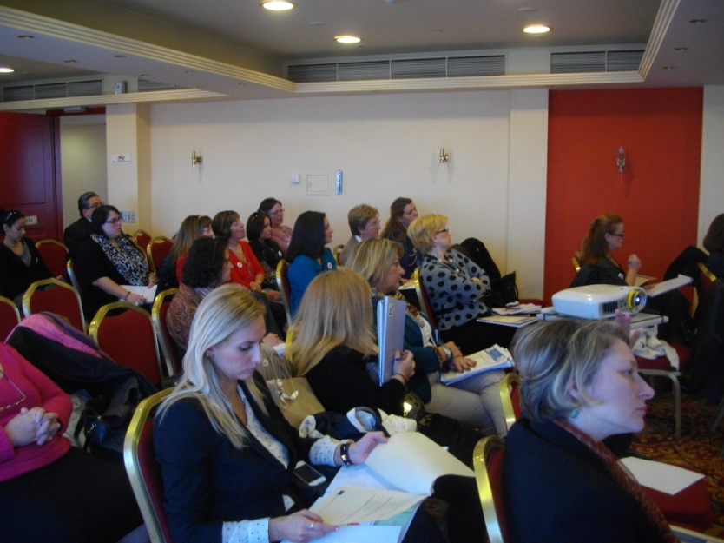
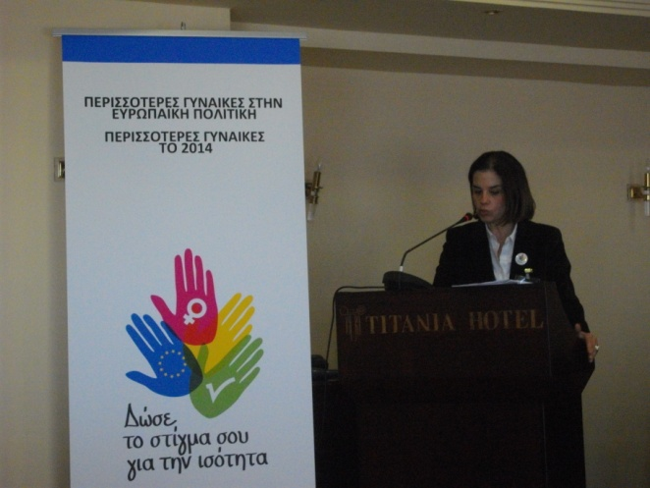
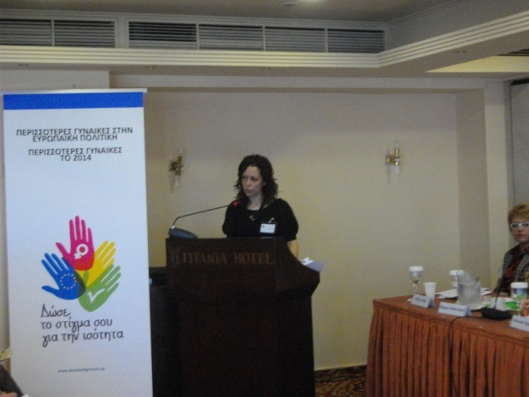
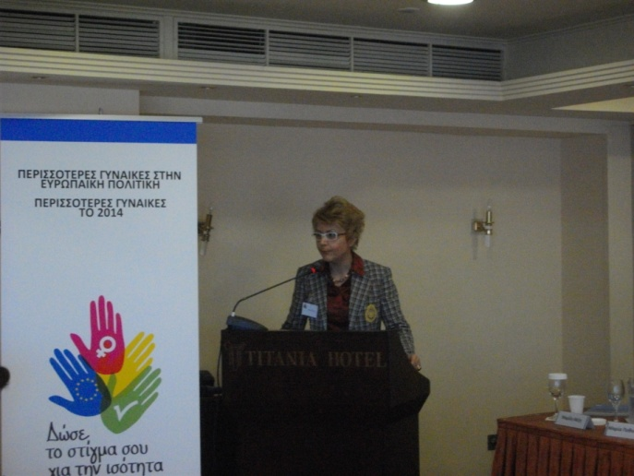
Awareness raising activities – Workshop I
With financial support from the “Fundamental Rights and Citizenship” Programme of the European Union

Slide 11
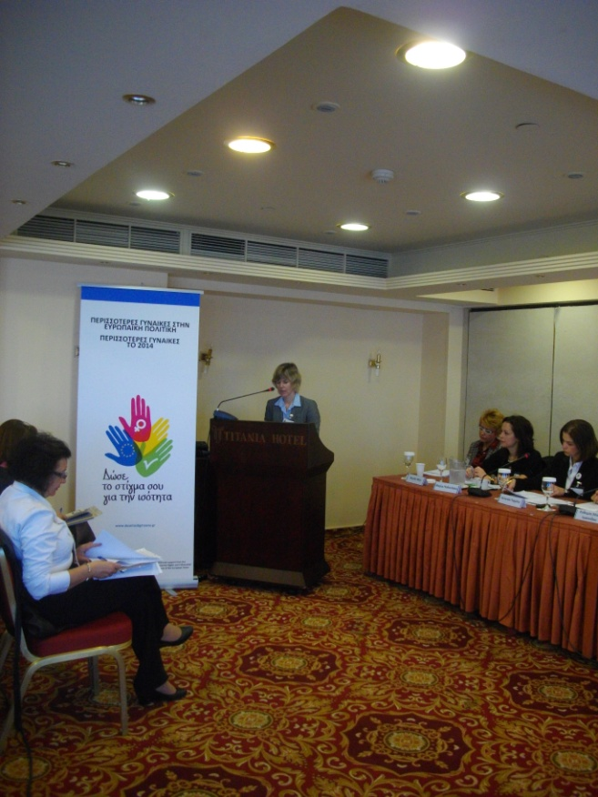
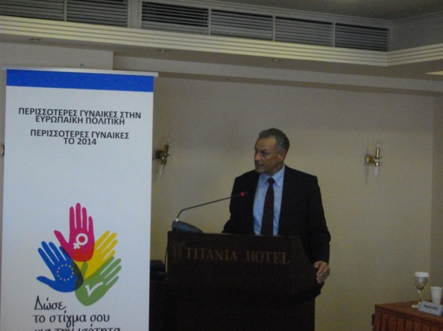
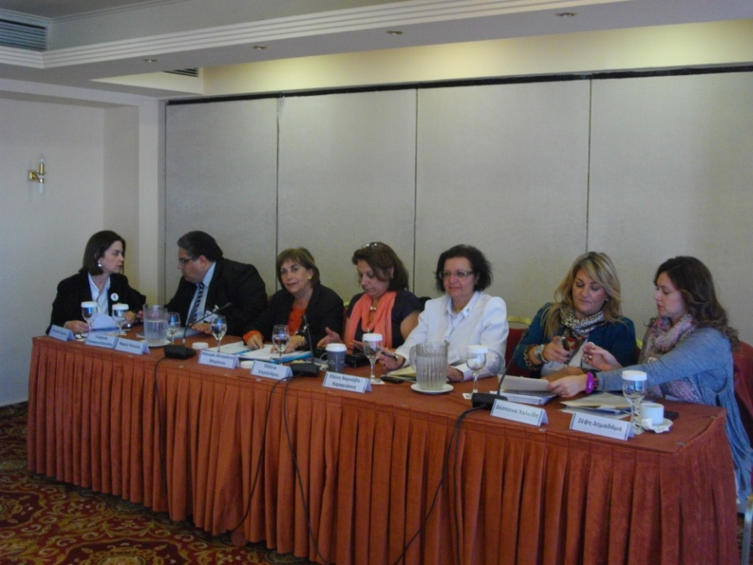
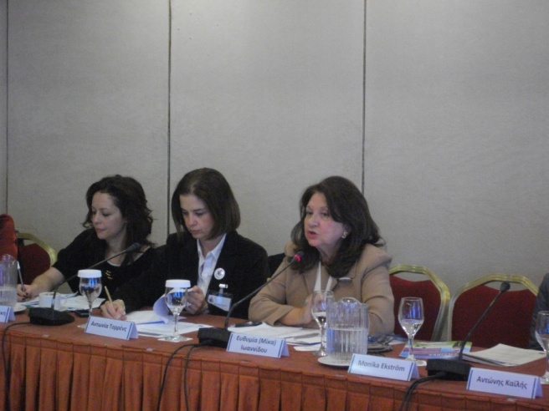
Awareness raising activities – Workshop I
With financial support from the “Fundamental Rights and Citizenship” Programme of the European Union

Slide 12
Awareness raising activities – Press Releases
Press Release I – October 2013
(Project Summary – Implementation of 1st Transnational Workshop in Tallin, Announcement of Workshop in Athens)
Press Release II – November 2013
(Implementation of one day workshop in Athens, 22nd November 2013, Topics discussed and Speakers)
Press Release III – January 2014
(Implementation of the Candidate Support Program in Athens,16-17 January 2014, training topics and participation)
Press Release IV – March 2014
(Celebration of Women’s Day – Need for the active involvement of Women in the socio-economic political process)
With financial support from the “Fundamental Rights and Citizenship” Programme of the European Union

Slide 13
Awareness raising activities – Radio Spot
The radio spot was produced and broadcast by “Radio Thessaloniki” targeting the area of Central Macedonia in Greece
With financial support from the “Fundamental Rights and Citizenship” Programme of the European Union

Slide 14
Awareness raising activities Radio Spot-live report
Live reports were broadcast at the afternoon show
“Life is Beautiful” by Radio Thessaloniki
With financial support from the “Fundamental Rights and Citizenship” Programme of the European Union

Slide 15
Local Action Strategy / Campaign
CANDIDATE SUPPORT PROGRAMME
Web survey
Candidate Support Programme
DISSEMINATION ACTIVITIES
Production of Dissemination Material
Participation in relevant events/networks
With financial support from the “Fundamental Rights and Citizenship” Programme of the European Union

Slide 16
Candidate Support Program- Web survey-Women in Politics: Characteristics and Trends
Methodology:
1st Stage: Variables for investigation through bibliography
2nd Stage: Use of web questionnaire (web survey)
*Questionnaire completion period remains open
With financial support from the “Fundamental Rights and Citizenship” Programme of the European Union

Slide 17
Demographic data 1
With financial support from the “Fundamental Rights and Citizenship” Programme of the European Union

Slide 18
Perception of women’s participation in the country’s political life and in the National Parliament
Low participation of women in political life and in the National Parliament
To what extent do you think that women in Greece participate in the country’s political life?
To what extent are you satisfied by the participation of women in our National parliament?
With financial support from the “Fundamental Rights and Citizenship” Programme of the European Union

Slide 19
Women Politicians – Positions of Political Responsibility
Women politicians are preferred in positions of political responsibility in sectors directly related to society (social policy, education, environment etc.). This perception remains the same regardless of respondents’ gender
To what extent do you think that a woman politician can deal with each of the topics below? (social policy, education, environment, health, economics, unemployment, corruption, immigration)
With financial support from the “Fundamental Rights and Citizenship” Programme of the European Union

Slide 20
Women and support by political parties
The perception is that women are not sufficiently supported by their political parties
To what extent do you think that women politicians are supported by their political parties?
With financial support from the “Fundamental Rights and Citizenship” Programme of the European Union

Slide 21
Women voters and influences
65% tends to believe that women voters are influenced by their male family members
To what extent do you think that women voters in Greece are influenced by their male-family members?
With financial support from the “Fundamental Rights and Citizenship” Programme of the European Union

Slide 22
Desired characteristics for a candidate / based on candidates’ gender (men/women)
How important do you consider each of the following characteristics for a political candidate (man/woman)? (Looks, Education status, Courage, Social Class, Economic situation, Morals)
Respondents tend to have increased demands in almost all of the characteristics for women political candidates as compared to their male colleagues
With financial support from the “Fundamental Rights and Citizenship” Programme of the European Union

Slide 23
Desired skills for a woman political candidate – comparison based on respondents’ gender
How important do you consider each of the following skills for a woman political candidate? (to understand voters’ problems, communication ability, ability to resolve problems, flexibility, persuasiveness
Women respondents have increased demands of women political candidates as compared to men respondents
With financial support from the “Fundamental Rights and Citizenship” Programme of the European Union

Slide 24
Important Findings – How far are we from gender equality?
Women are considered having low participation in the political life of the country and in the National Parliament
Women respondents do not think that their needs and interests are sufficiently represented by women politicians
Stereotypes – women politicians were considered more competent in dealing with ‘soft’ issues such as social policy, education and environment
Women voters are influenced by their male family members
Women politicians are not sufficiently supported by their political parties
Women respondents tend to acknowledge to a greater extent than men the difficulties that young women political candidates face in Greece-
Reconciliation of family life with professional and political obligations
‘Looks’ is a more desired characteristic in women political candidates than in men
Women have greater demands/expectations from women politicians than from men politicians
With financial support from the “Fundamental Rights and Citizenship” Programme of the European Union

Slide 25
Candidate Support Program
Two day training program for women political candidates and potential candidates
16-17 January 2014, Athens
17 candidates/potential candidates - trainees
Curriculum – communication and politics
Communication and political expert
Follow up of trainees the week after the elections (telephone questionnaire)
With financial support from the “Fundamental Rights and Citizenship” Programme of the European Union

Slide 26
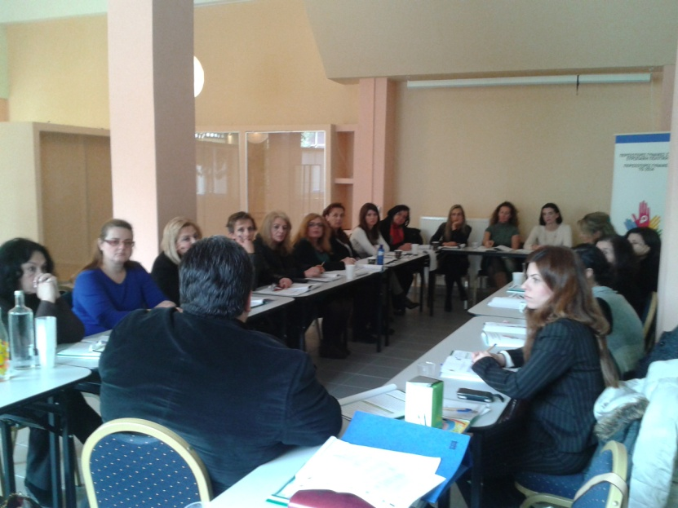
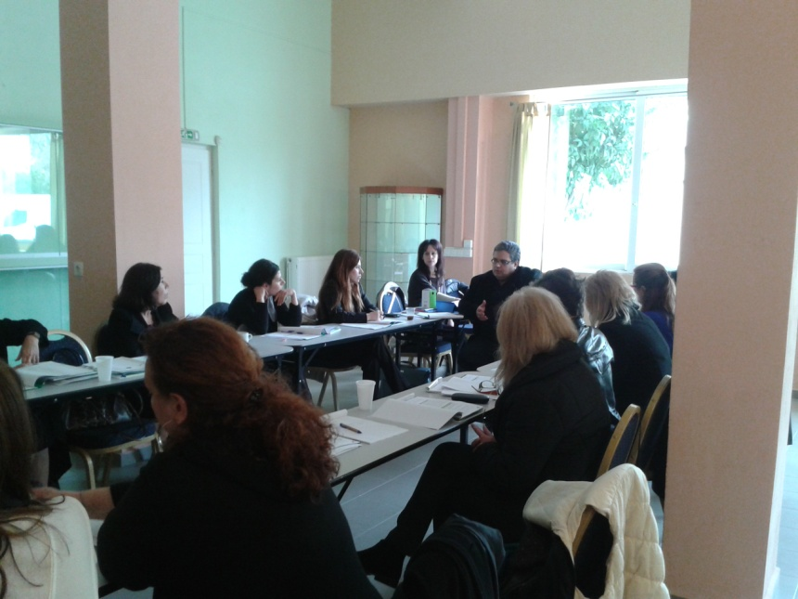
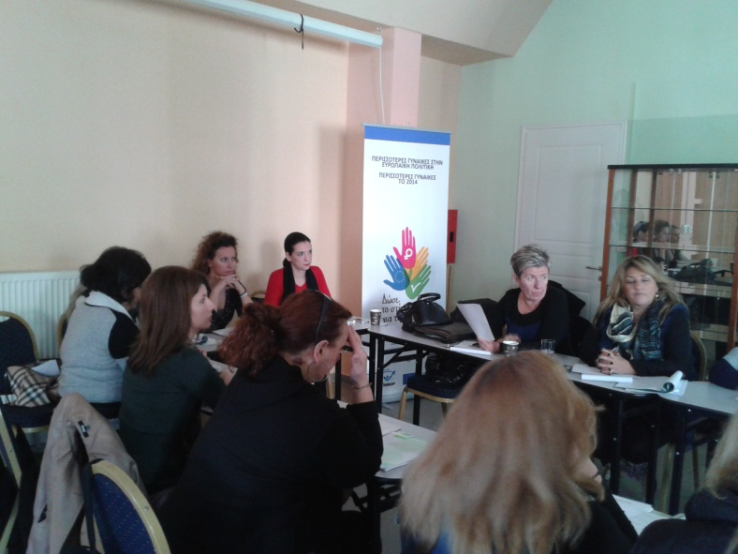
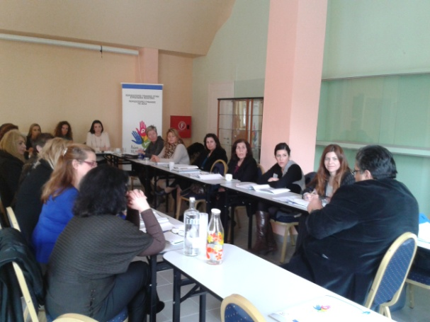
Candidate Support Program
With financial support from the “Fundamental Rights and Citizenship” Programme of the European Union

Slide 27
Candidate Support Program – Follow up
13 out of 17 trained women - candidates (76,47%)
4 women decided not to be candidates (23,53%) at the recent elections, due to family and professional obligations.
With financial support from the “Fundamental Rights and Citizenship” Programme of the European Union

Slide 28
Candidate Support Program - Follow up
Out of the 13 candidates:
2 women candidates for European Parliament Elections
6 women candidates for Regional Councillors (Regional Elections)
5 women candidates for City Councillors (Local Goverment Elections)
With financial support from the “Fundamental Rights and Citizenship” Programme of the European Union

Slide 29
Candidate Support Program – Follow up
Training sections rated higher by candidates as most useful for their political campaign:
Presentation in public events and TV shows
Candidate’s material (cards, leaflets, website, social media etc.)
Specification of the candidate’s political identity
With financial support from the “Fundamental Rights and Citizenship” Programme of the European Union

Slide 30
Dissemination activities – dissemination material
Dissemination material
Leaflets, postcards, training folders, badges, banner
(distribution in all KMOP branches)
With financial support from the “Fundamental Rights and Citizenship” Programme of the European Union

Slide 31
Dissemination activities – Participation in events/activities & Networking
Participation in the Network ‘Eleni Skoura’ of the Project “Encouraging and Supporting the Participation of Women in Positions of Political Responsibility in National and European Level” (Research Center for Gender Equality) (January, 2013 – ongoing)
18th Hellenic Conference of Elected Women at Local Government Level (13-16 June 2013) Mrs Eleni Varnava
Participation in consultation sessions for the promotion of women in decision making, organised by the General Secretariat for Gender Equality (October, 2013)
Creation of a City Council Committee for Gender Equality at the Municipality of Oropos, Mrs Eleni Varnava (President of the Committee)
Congress of the European Socialist Party in Athens (9/3/2014, Stadium of Peace and Friendship) Mrs Christina Kokota
With financial support from the “Fundamental Rights and Citizenship” Programme of the European Union

Slide 32
European Parliament & Local Government Elections - Greece
With financial support from the “Fundamental Rights and Citizenship” Programme of the European Union

Slide 33
European Parliament Elections – Candidates
Candidates per political party * and gender
*the graph presents the most popular political parties
Source: Hellenic Ministry of Interior
With financial support from the “Fundamental Rights and Citizenship” Programme of the European Union

Slide 34
European Parliament Elections – Greece II
Source: Hellenic Ministry of Interior
With financial support from the “Fundamental Rights and Citizenship” Programme of the European Union

Slide 35
European Parliament Elections – Greece III
Elected per political party * & gender
*the graph presents the most popular political parties
With financial support from the “Fundamental Rights and Citizenship” Programme of the European Union
Source: Hellenic Ministry of Interior

Slide 36
Men & Women Candidates Vs Men and Women Elected in European Parliament (per political party*)
Source: Hellenic Ministry of Interior
With financial support from the “Fundamental Rights and Citizenship” Programme of the European Union

Slide 37
Elected members of the European Parliament –
Comparison with previous EP elections
There was a decrease in the number of women elected members in the European Parliament in the current elections (23,8%), in comparison to previous elections (31,8%)
With financial support from the “Fundamental Rights and Citizenship” Programme of the European Union
Source: Hellenic Ministry of Interior

Slide 38
European Parliament Elections Participation/ Abstention - 2014
European Parliament Elections Participation/ Abstention
 | Actual Number | Percentage
Registered | 9.893.051
Voted | 5.932.100 | 59,96%
Valid | 5.706.606 | 96,20%
Invalid | 158.622 | 2,67%
Blank | 66.872 | 1,13%
Abstention | 3.960.951 | 40,04%
With financial support from the “Fundamental Rights and Citizenship” Programme of the European Union
Source: Hellenic Ministry of Interior

Slide 39
European Parliament Elections Results – Abstention in comparison with previous elections and EU
*estimated
Sources: European Parliament & Hellenic Ministry of Interior
With financial support from the “Fundamental Rights and Citizenship” Programme of the European Union

Slide 40
Local Government Elections 2014 - Candidates
153 women (10,6%) and 1288 men (89,4%), in total 1441, were candidates for Mayors in 325 Municipalities.
With financial support from the “Fundamental Rights and Citizenship” Programme of the European Union
Source: Hellenic Ministry of Interior

Slide 41
Municipal Elections elected Mayors per gender - 2014
15 women (4,6%) and 310 men (95,4%) are elected as Mayors in 325 Municipalities.
With financial support from the “Fundamental Rights and Citizenship” Programme of the European Union
Source: Hellenic Ministry of Interior

Slide 42
Candidates Mayors Vs Elected Mayors per gender - 2014
With financial support from the “Fundamental Rights and Citizenship” Programme of the European Union
Source: Hellenic Ministry of Interior

Slide 43
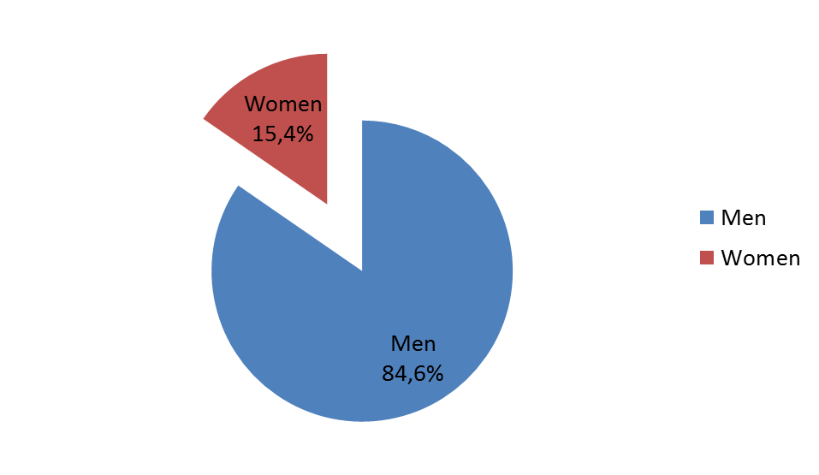
Regional Elections – Elected Regional Governors per Gender
Regional Elections - Elected Regional Governors
With financial support from the “Fundamental Rights and Citizenship” Programme of the European Union
Source: Hellenic Ministry of Interior

Slide 44
Steps towards Gender Equality - Suggestions
Coordinated efforts to increase the number of women in politics
Actual support of women who want to be actively involved in politics (services to help them reconciliate family, politics and professional life)
Actual support from political parties
Solidarity among women
Gender stereotypes…towards a different social construction!
With financial support from the “Fundamental Rights and Citizenship” Programme of the European Union

Slide 45
published by www.Kingsoftstore.com
Gender equality
How far are we?
Thank you!
With financial support from the “Fundamental Rights and Citizenship” Programme of the European Union

