Slide 1
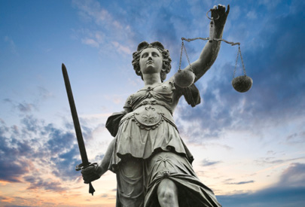
Liberal Women
Sweden
Bonnie Bernström

Slide 2
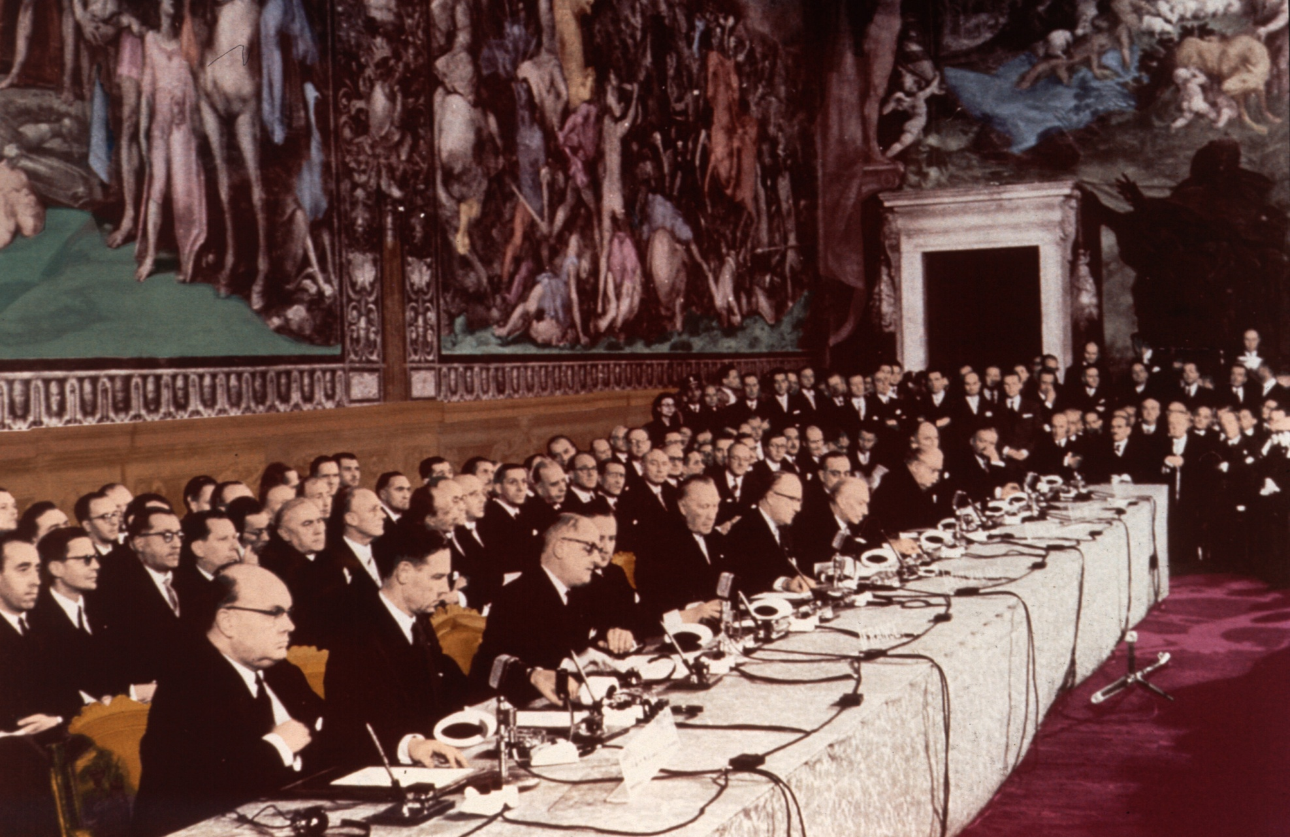
Rom 1957
Notes:
2

Slide 3
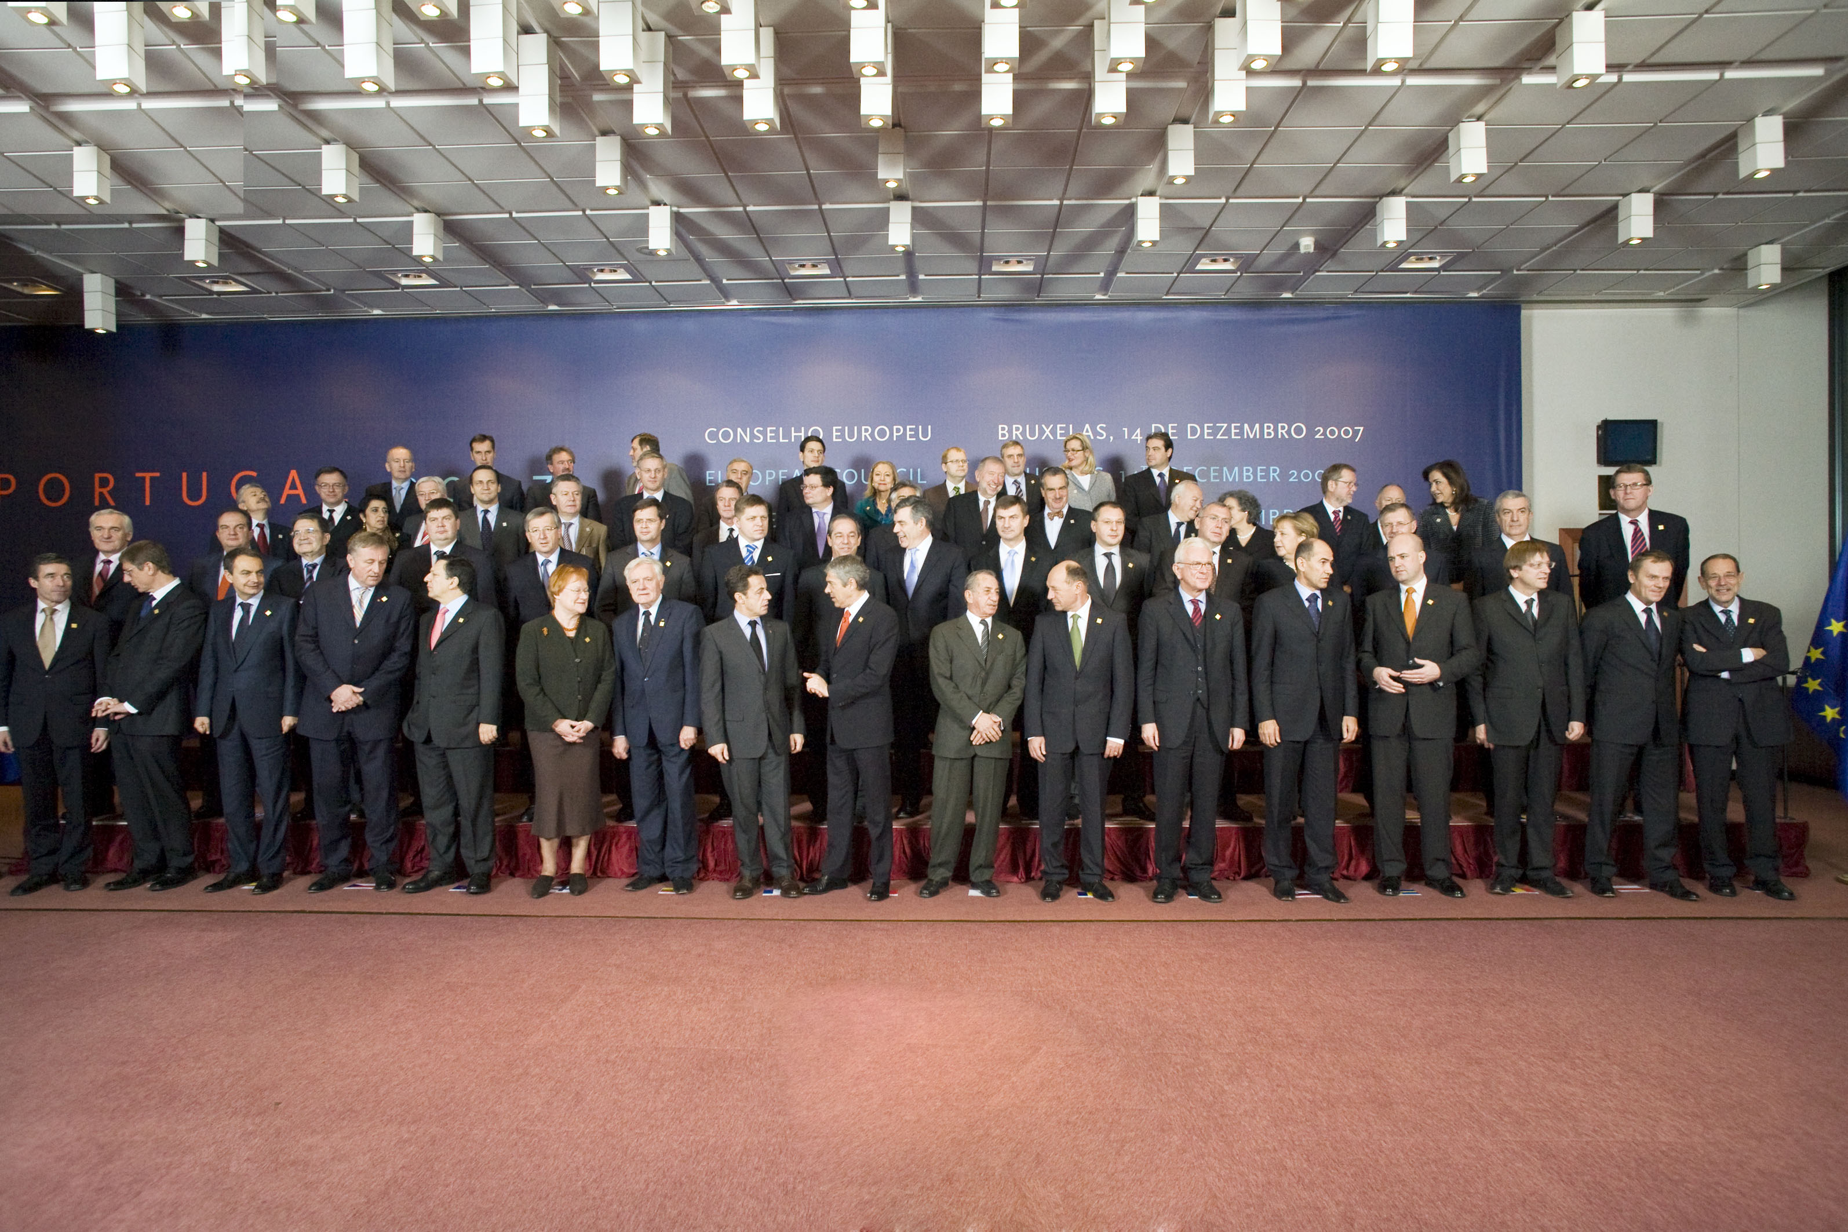
European Union
Maktstrukturerna
Lissabon 2007
… Gender Equality is a prerequisite for achieving a sustainable development and economical growth (Lisbon Treaty)
Notes:
3

Slide 4
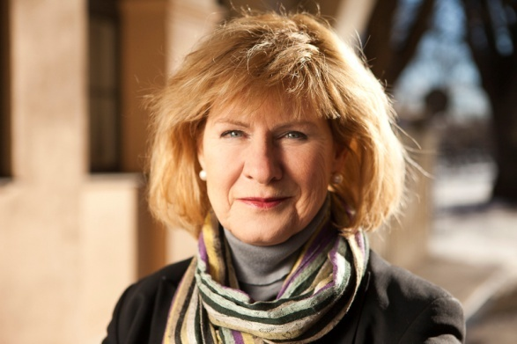
Bonnie Bernström

Slide 5


Slide 6
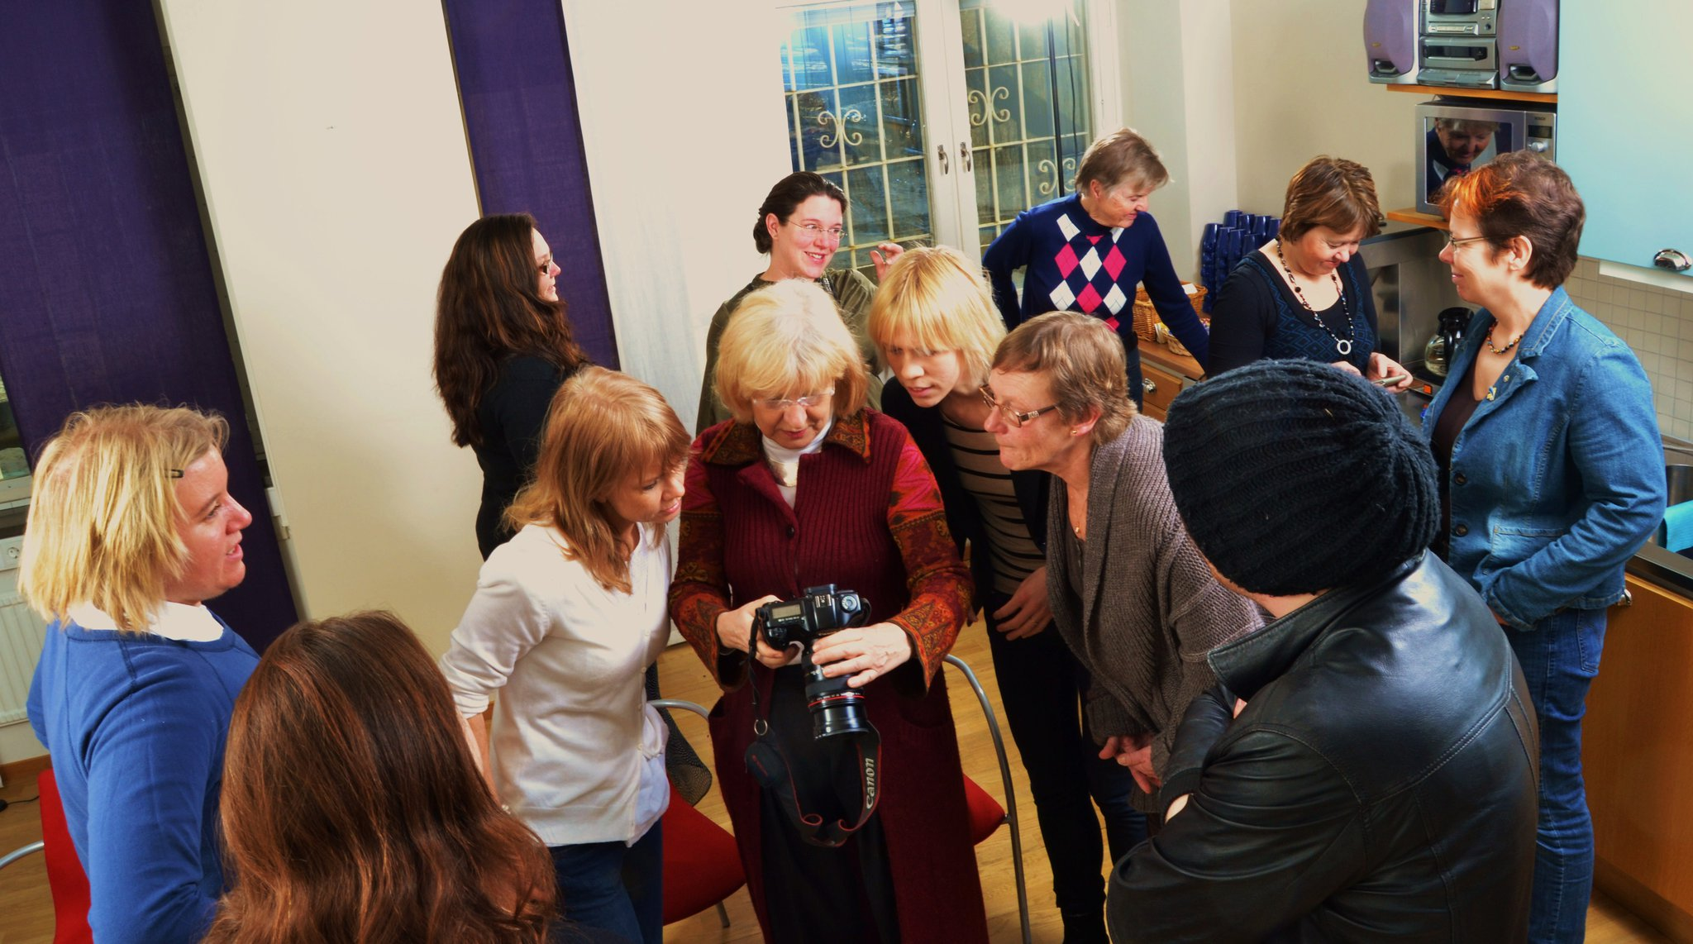
The Board of Liberal Women in 2010

Slide 7
Liberal Women
– a wing of the Liberal party
Founded in 1935
Historical roots to the movement of Women’s
Right to Vote
A political feministic platform
Nation-wide with10 districts and 10 network
State funded
Office in the Parliament

Slide 8
Liberal Women – mission
To promote women feminists in politics
To promote a feministic politics

Slide 9
Liberal Women – vision
Women and men shall have the same freedom, rights
and duties within all areas in the society!

Slide 10
Liberal Women – actions
One yearly big national conference or congress
Monthly regional meetings
Organizing actual demonstrations
Publishing articles
Organising internet campaigns 6-8 times per year
Participating actively in the promotion of politics
within the party.
Cooperation cross border with other women’s NGO
Board meetings
Yearly conferences for local chairs

Slide 11
Tre skäl för att vara medlem i Liberala Kvinnor:
Festligt!
Feministiskt
Framtid!

Slide 12
Three F-reasons to be a member
of Liberal Women:
Festival!
Feminism!
Future!

Slide 13
Question nr 1:
Women as elected in national parliament, regional,
local assemblies.

Slide 14
The Swedish results of the EU-election in 2009
By 20 elected candidates, 11 were women and 9 men.
By 13 candidates elected by preference votes
– 7 were women and 6 were men.
60% of all voters made a preference vote.
Two elected women were under 30 years old.
Slightly more than 20% of all candidates were under 30 years.
About 20% of all voters were under 30 years.

Slide 15
Preference voting in the EU-election 2009
The one who had most preference votes was a women. She had
221489 pref votes.
Number two was as well a women with 173894 pref votes.
Number three was a man with 90505 pref votes

Slide 16
Swedish government:
13 women
11 men

Slide 17
Parliament – elected 2010
Gender division by age
Source: SCB

Slide 23
Conclusions:
The proportion of women elected is bigger
than the proportion of women nominated.
Though, men have 50% or more of the representation.
Reasons?
Men control the parties?
Either are women ranked by their parties
higher up on the ballot or..
...women catch more preference votes.

Slide 24
Question nr 2
Women’s membership within political parties.

Slide 26
Question nr 3
Actions undertaken

Slide 27
6 of 8 parliamentary parties have a women’s wing
2 have gender councils.
Women’s wing have a state grant related to the number of
seats of the party.
All women’s wings see it as their primary task to promote women
In the elections and to promote gender policies within their parties.

Slide 28
Special training for women who want to run for parliament
(3 levels – all, regional and selected).
Minor mentorship programmes
Networks (Isabella, Fredrika)
Special grants for women who wanted to run for Parliament
Flyers and posters on main candidates.
Special attention to election committees.
Campaings in the test elections.

Slide 29
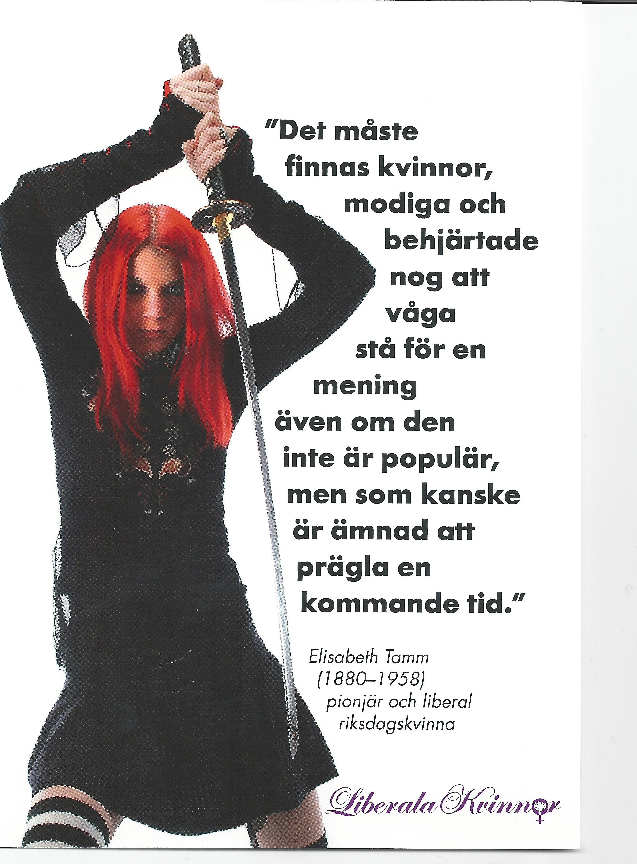

Slide 30
Question nr 4
Actions taken at the legislative level

Slide 31
No constitutional or legislative quota.
Volontary quotas by some parties – zebra model
State grant to women’s NGOs

